Slide 1


COURSE: “CYBER FORENSICS AND ETHICAL HACKING”
TOPIC 1
WINDOWS OS
SECURITY
Lesson 1 · Windows OS Services | Lecture, 2 hours
REPUBLIC OF UZBEKISTAN
UNIVERSITY OF MILITARY SECURITY AND DEFENSE
Institute of ICT and Military Communications · Cybersecurity Department
Lecturer: Senior Lecturer, Cybersecurity Department — Captain M. Isakov

Slide 2


COURSE OVERVIEW
Classroom hours — distribution
180
What is a classroom session?
Sessions taught in class with an instructor: lecture, practical and seminar.
Main focus — practical sessions (160 hours): the cadet applies theory in a real/virtual environment.
Each semester — 60 classroom hours; 180 hours across 3 semesters.
classroom hours
Taught in semesters 5, 6 and 7
(60 hours each)
Note: there is also independent study (150 hours), but lessons are delivered specifically in the classroom hours.
KKvaEH · Topic 1 · Windows OS Security
2

Slide 3


COURSE OVERVIEW
Course goal and expected outcomes
GOAL — what we want to achieve
EXPECTED OUTCOME — what the cadet will be able to do
To train the cadet as a cybersecurity officer who understands Windows and Linux systems from the inside, can find malicious software, track digital traces in networks and systems, and can carry out both attack and defense in practice.
In short: teaching not “which button to press”, but how the system works and how to protect it.
▸ Manage a Windows/Linux system at administrator level
▸ Recognize and analyze viruses and malicious code
▸ Know and apply SIEM, EDR, DLP, IPS/IDS defense systems
▸ Work with Metasploit and network scanners
▸ Collect information from open sources via OSINT
KKvaEH · Topic 1 · Windows OS Security
3

Slide 4





COURSE OVERVIEW
Course structure — 3 semesters, 6 topics
Semester 5
60 hours
Semester 6
60 hours
Semester 7
60 hours
Topic 1. Windows OS security
Topic 4. Network monitoring & security systems (DLP, IDS/IPS, SIEM, EDR, Metasploit)
Topic 5. Cyber intelligence & ethical hacking (OSINT, C2, forensics)
Topic 2. Linux OS
Topic 6. Project development & defense
Topic 3. Malware analysis
Today’s session — Topic 1 (Windows OS security), its Lesson 1: Windows OS Services.
KKvaEH · Topic 1 · Windows OS Security
4

Slide 5


TOPIC 1 · WINDOWS OS SECURITY
Lesson 1: Windows OS Services (Lecture)
Topic
Session type
Duration
Windows OS security
Lecture
2 hours
Learning questions
1
Service properties and functions
2
Starting and managing services
KKvaEH · Topic 1 · Windows OS Security
5

Slide 6

QUESTION 1
Service properties and functions
6

Slide 7




QUESTION 1 · SERVICE PROPERTIES
What is a Windows service?
Ordinary program
Service
▸ Has a window on screen, you open it (Word, browser)
▸ You launch it when you are logged in
▸ No window, runs invisibly in the background
▸ Starts automatically when the system boots
3 key differences between a service and an ordinary program:
No user needed
Automatic
Under a special account
Runs even when no one is logged in
Starts by itself as soon as Windows boots
With SYSTEM, LocalService or NetworkService rights
KKvaEH · Topic 1 · Windows OS Security
7

Slide 8


QUESTION 1 · SERVICE PROPERTIES
Why are services important for cybersecurity?
High privilege
Persistence
Privilege escalation
Many services run at SYSTEM level — the highest right in Windows, even stronger than administrator. Taking over a service = controlling the whole system.
Malware registers itself as a new service — so it restarts automatically even after the computer reboots (it gains persistence).
Through a misconfigured service (e.g. unquoted service path), an ordinary user can rise to SYSTEM rights.
KKvaEH · Topic 1 · Windows OS Security
8

Slide 9
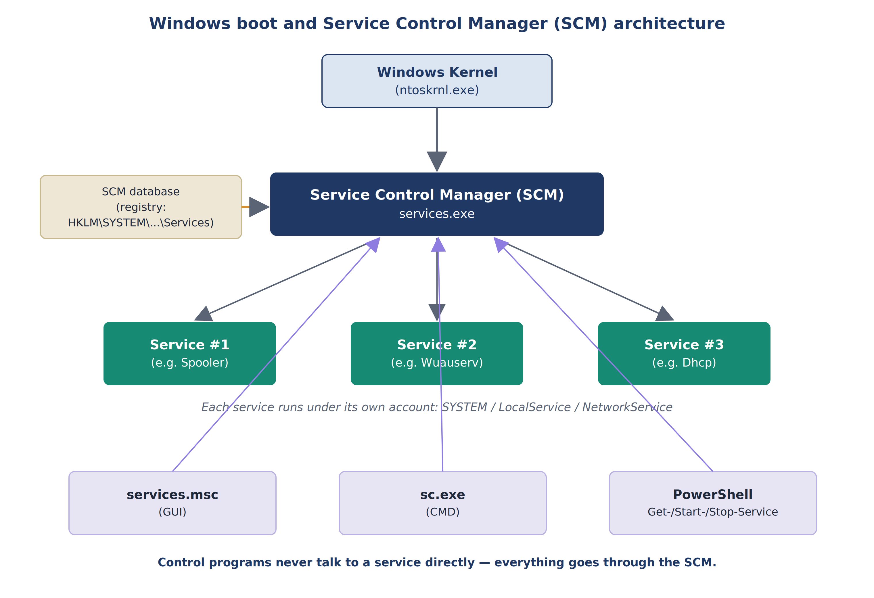
QUESTION 1 · SERVICE PROPERTIES
Service Control Manager (SCM) — the services “controller”
▸ The Kernel (ntoskrnl.exe) starts first.
▸ It launches services.exe — i.e. the SCM.
▸ SCM reads the full list of services from the registry.
▸ SCM starts them, monitors their state, and sets their permissions.
▸ services.msc, sc.exe, PowerShell do not talk to a service directly — everything goes through the SCM.
Fig. 1. Windows boot and SCM architecture
KKvaEH · Topic 1 · Windows OS Security
9

Slide 10
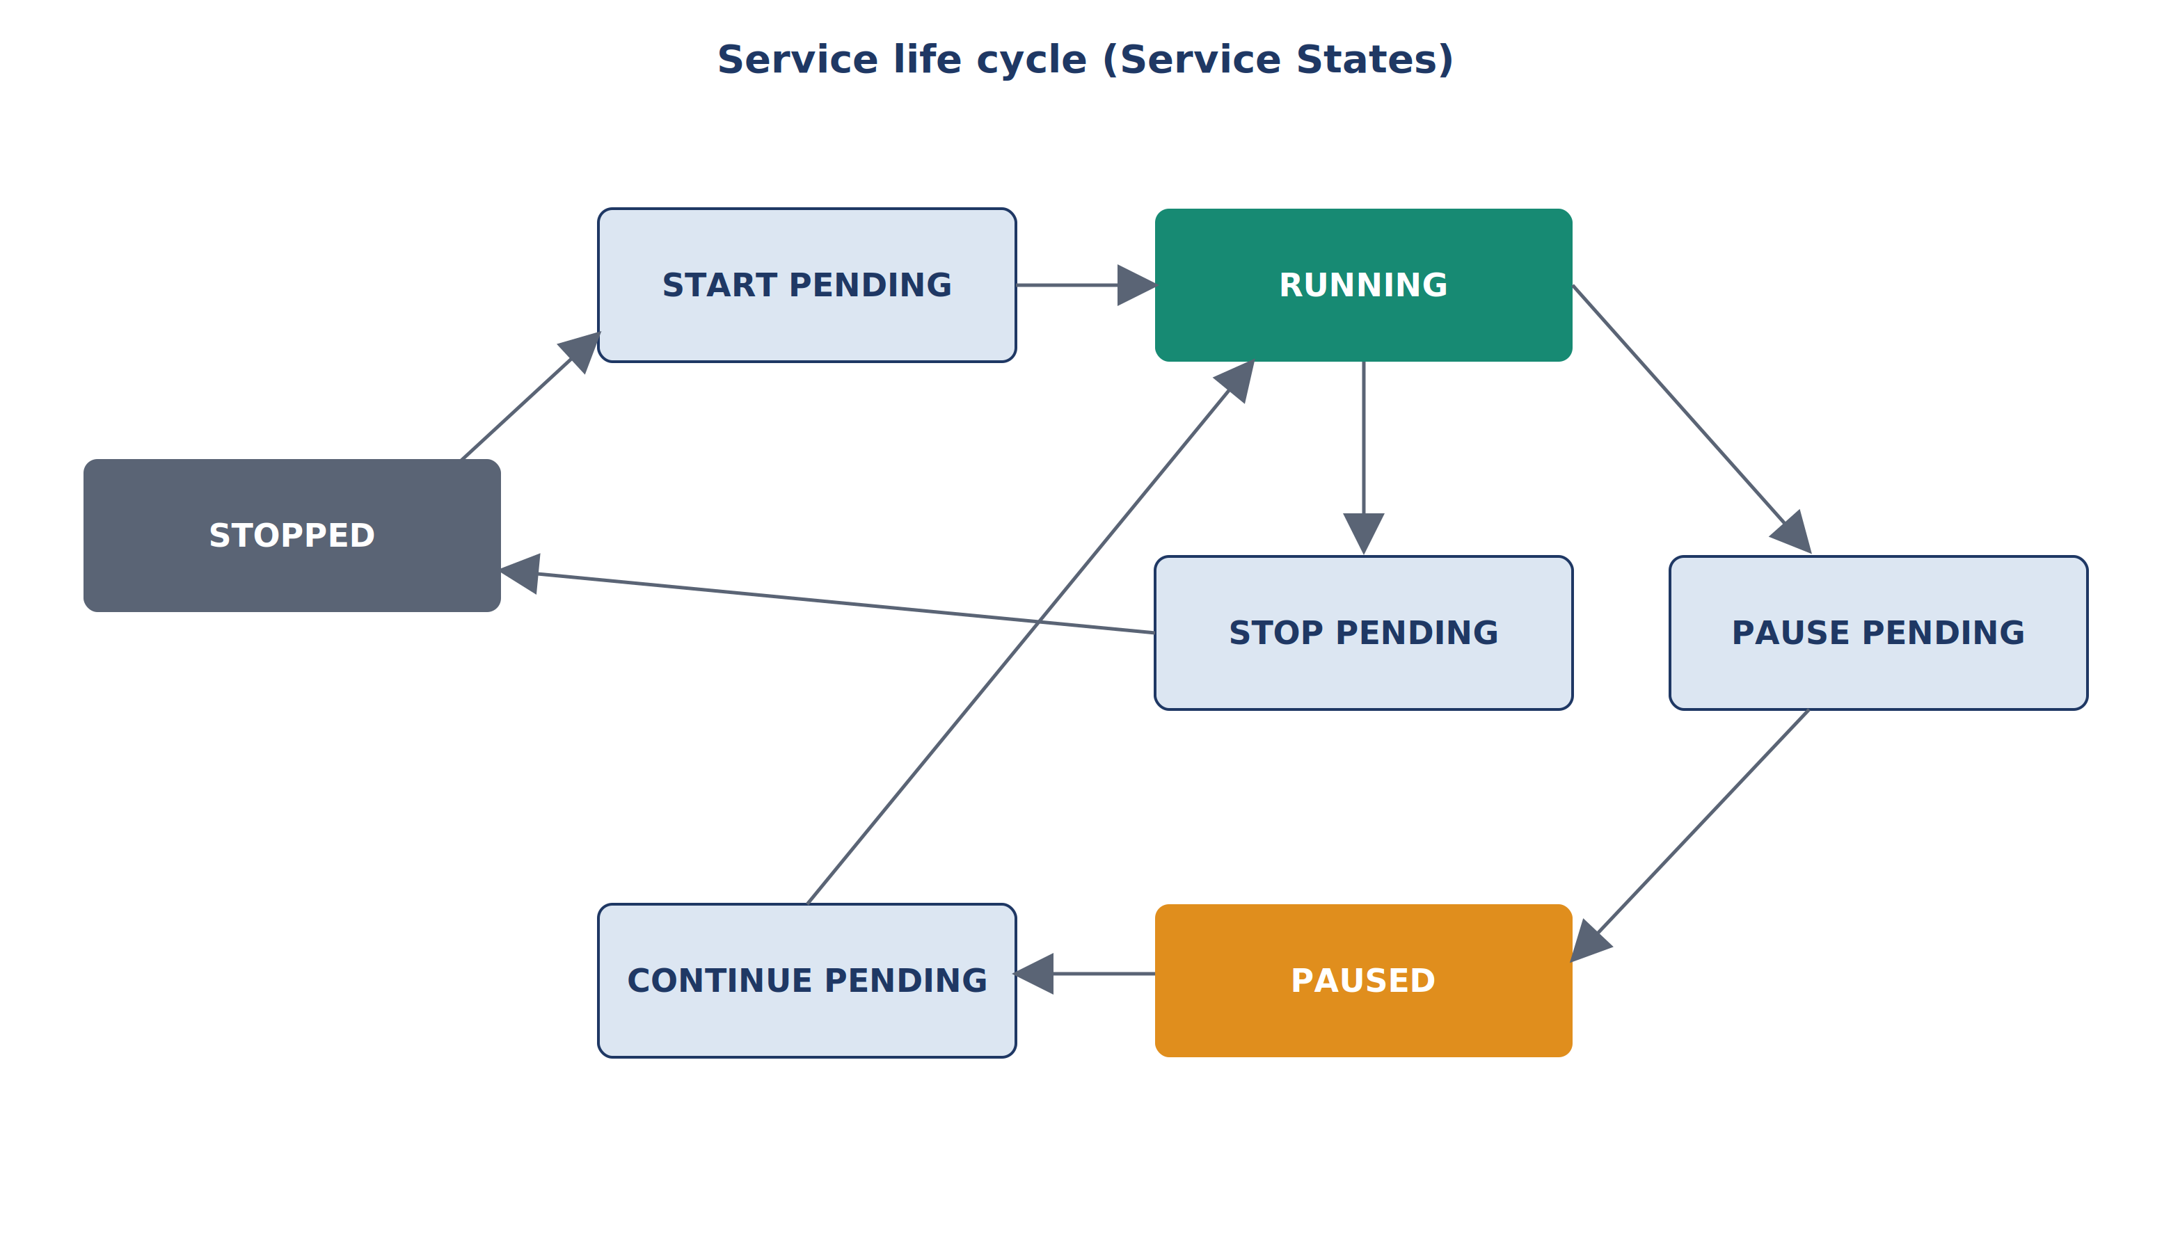
QUESTION 1 · SERVICE PROPERTIES
Service life cycle (Service States)
Main states:
▸ Stopped — halted, not running
▸ Start Pending — in the process of starting
▸ Running — fully running
▸ Paused — temporarily suspended
▸ Stop Pending — in the process of stopping
Fig. 2. Service states and transitions between them
KKvaEH · Topic 1 · Windows OS Security
10

Slide 11


QUESTION 1 · SERVICE PROPERTIES
Startup Types
Automatic
Automatic (Delayed)
Manual
Disabled
Starts immediately when the system boots
Starts a bit later, after boot completes
Starts only when requested
Never starts at all
When:
When:
When:
When:
Critical, always-on services (network, Update)
Needed, but not required immediately
Rarely used ones (Print Spooler)
Unused ones that may be risky
KKvaEH · Topic 1 · Windows OS Security
11

Slide 12
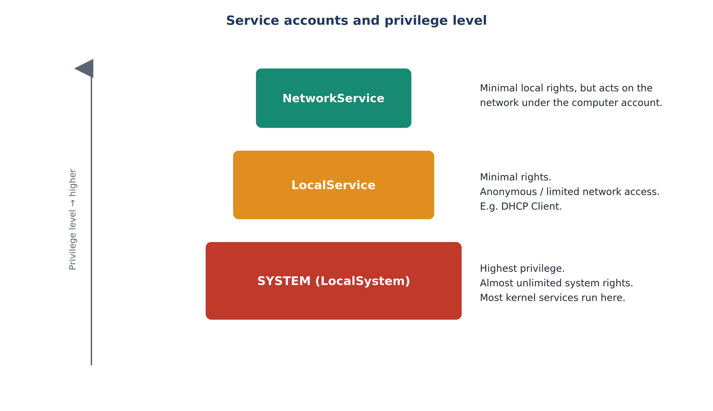
QUESTION 1 · SERVICE PROPERTIES
Under which account does a service run?
SYSTEM — the highest, almost unlimited rights.
LocalService — minimal rights, limited network access.
NetworkService — minimal, but active on the network.
Security rule:
“least privilege” — the fewer rights a service is given, the safer the system.
A SYSTEM-level service is the most valuable prize for an attacker.
Fig. 3. Service accounts and their privilege level
KKvaEH · Topic 1 · Windows OS Security
12

Slide 13
QUESTION 2
Starting and managing services
13

Slide 14
QUESTION 2 · STARTING SERVICES
3 tools for managing services
GUI
CMD
PowerShell
services.msc
sc.exe
Get-Service
A graphical window used with the mouse. Shows all services, their state and the “Log On” column.
The classic command-line tool. Syntax: sc [command] [service_name] [parameters].
Modern, great for automation. Verb-Noun cmdlets: Get-Service, Start-Service.
KKvaEH · Topic 1 · Windows OS Security
14

Slide 15
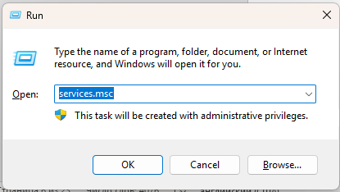
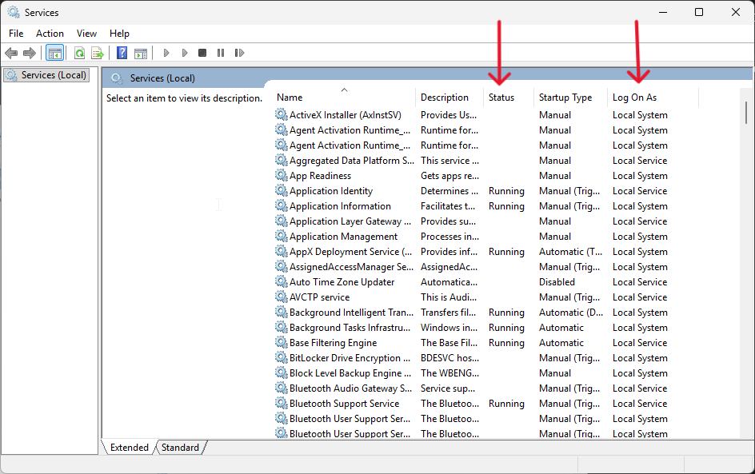
QUESTION 2 · STARTING SERVICES
Via the GUI — services.msc
Win
+
R
→ services.msc → Enter
To open:
Fig. 4. services.msc in the Run box
▸ Status — Running / Stopped
▸ Startup Type — Automatic / Manual…
▸ Log On As — under which account
Fig. 5. Services window: Status, Startup Type and Log On As columns
KKvaEH · Topic 1 · Windows OS Security
15

Slide 16

QUESTION 2 · STARTING SERVICES
Via CMD — sc.exe commands
Command | What it does | Example
sc query <name> | Shows the current state of a service | sc query Spooler
sc start <name> | Starts a service | sc start Spooler
sc stop <name> | Stops a service | sc stop Spooler
sc qc <name> | Full configuration (file path, account) | sc qc Spooler
sc config <name> start= disabled | Changes the startup type | sc config Spooler start= disabled
Note: leave a space after the “=” sign (start= disabled), but no space before it.
KKvaEH · Topic 1 · Windows OS Security
16

Slide 17
QUESTION 2 · STARTING SERVICES
Via PowerShell — cmdlets
Cmdlet | Verb (what it does) | Noun (on what)
Get-Service | Get — retrieve, view | Service
Start-Service | Start — launch | Service
Stop-Service | Stop — halt | Service
Set-Service | Set — configure | Service
A cmdlet — a command that lives only inside PowerShell (not an ordinary .exe file).
It is always named in Verb-Noun form: Get-Service, Start-Service. That is why Get-Service does not work in CMD — only in PowerShell.
KKvaEH · Topic 1 · Windows OS Security
17

Slide 18
QUESTION 2 · PRACTICAL SIGNIFICANCE
sc qc — why it matters for security
> sc qc Spooler
BINARY_PATH_NAME :
C:\Windows\System32\spoolsv.exe
SERVICE_START_NAME : LocalSystem
▸ BINARY_PATH_NAME — the file path. If unquoted and contains spaces — it may be an unquoted service path vulnerability.
▸ SERVICE_START_NAME — shows which account the service runs under.
▸ In forensics and ethical hacking, sc qc is one of the first commands to check.
Blue Team: sets unnecessary services to Disabled to reduce the attack surface.
Red Team / Forensics: hunts for newly created or misconfigured services.
Terms (click for explanation):
? Unquoted service path
? MITRE ATT&CK
? cmdlet
KKvaEH · Topic 1 · Windows OS Security
18

Slide 19

WRAP-UP
Summary
Windows services — programs that run automatically in the background under special system accounts.
All services are managed by the Service Control Manager (SCM); the list is stored in the registry.
Three ways to manage them: GUI (services.msc), CMD (sc.exe), PowerShell (cmdlets).
A misconfigured service is a risk for privilege escalation and persistence.
This knowledge is the foundation for later topics (malware analysis, network monitoring).
KKvaEH · Topic 1 · Windows OS Security
19

Slide 20
WRAP-UP
Review questions — Lesson 1
How does a Windows service differ from an ordinary program?
Why can a misconfigured service lead to privilege escalation?
1
5
What is the difference between the SYSTEM, LocalService and NetworkService accounts?
What is the difference between the sc query and sc config commands?
2
6
What functions does the SCM perform and where is it located?
Why is checking services important in forensic analysis?
3
7
Name the 4 startup types and explain when each is used.
4
KKvaEH · Topic 1 · Windows OS Security
20

Slide 21

THANK YOU FOR YOUR ATTENTION!
Questions are welcome.
Next section — glossary of terms

Slide 22

GLOSSARY
Glossary — this section explains the following
Service
Service Control Manager
Registry
Startup type
a program running in the background
the services dispatcher
the Windows settings database
when it starts
Service accounts
Unquoted service path
MITRE ATT&CK
cmdlet
SYSTEM/LocalService…
a dangerous vulnerability
a knowledge base of attack techniques
a PowerShell command
Each term is explained in beginner-friendly language, with an example and a diagram.
KKvaEH · Topic 1 · Windows OS Security
21

Slide 23
GLOSSARY · TERM EXPLAINED
22
Service Control Manager (SCM)
In plain terms:
Kernel (ntoskrnl.exe)
The SCM is the “boss” or dispatcher of all services. It runs as the services.exe file. When Windows boots, the kernel launches it; then the SCM reads the list in the registry and starts, stops and monitors each service.
SCM — services.exe
Registry: HKLM\SYSTEM\...\Services
Why it matters:
If you say “stop the Spooler”, the command does not go straight to the service — it goes to the SCM first, and the SCM carries it out. All control passes through the SCM.
Spooler
Wuauserv
Dhcp
← Back to lesson

Slide 24

GLOSSARY · TERM EXPLAINED
23
Unquoted Service Path (vulnerability)
The problem: a service file path is unquoted and contains spaces. For example:
C:\Program Files\My App\service.exe
When it hits a space, Windows tries each of these in order:
C:\Program.exe
← if an attacker places a malicious file here, this runs first!
C:\Program Files\My.exe
← this is also tried
C:\Program Files\My App\service.exe
← the real, correct file (last of all)
Worst of all: because the service runs with SYSTEM rights, the malicious file also runs with SYSTEM rights — an ordinary user takes over the whole system. Fix: always put the path in quotes.
← Back to lesson

Slide 25
GLOSSARY · TERM EXPLAINED
24
MITRE ATT&CK
In plain terms:
MITRE ATT&CK is a free, open knowledge base that organizes and catalogs the tactics and techniques attackers use in the real world (for example, “unquoted service path”).
Cybersecurity professionals use it to understand, detect and defend against attacks — it is the shared “vocabulary” of the field.
Example
Our vulnerability is coded in the base as:
T1574.009
Hijack Execution Flow: Path Interception by Unquoted Path
Source: attack.mitre.org
← Back to lesson

Slide 26
GLOSSARY · TERM EXPLAINED
25
cmdlet (a PowerShell command)
In plain terms:
Verb + Noun = cmdlet
A cmdlet (pronounced “command-let”) is a small PowerShell command that does one specific job. It is not an ordinary .exe program — it runs only inside PowerShell.
A cmdlet is always named in “Verb-Noun” form: first what it does (verb), then on what (noun).
Get-Service
Get (retrieve) · Service
Start-Service
Start (launch) · Service
Stop-Service
Stop (halt) · Service
Note: Get-Service will not work if you type it in CMD — only in PowerShell.
← Back to lesson

